Slide 1
CCA and Weighted Averaging
Lab 9
Brittany Hupp

Slide 2
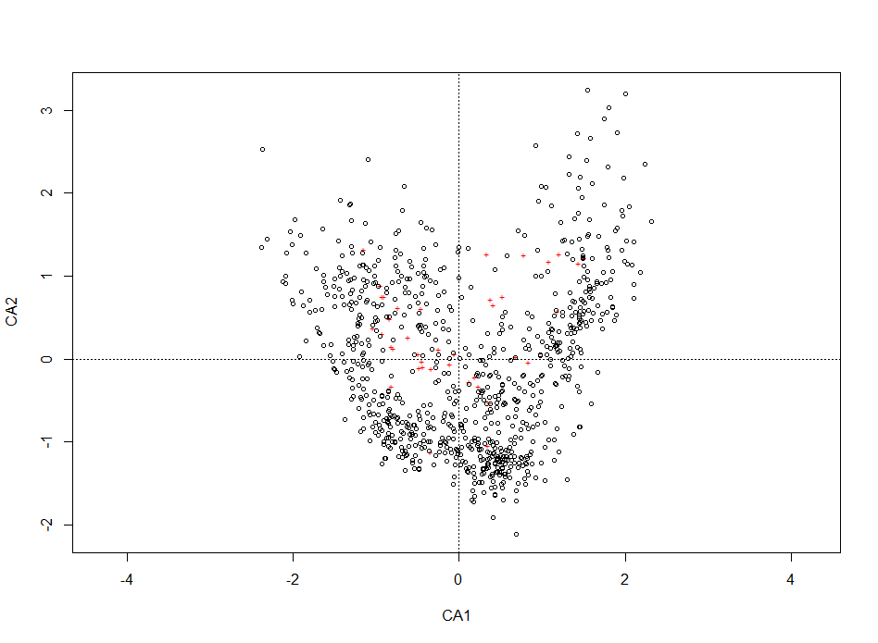
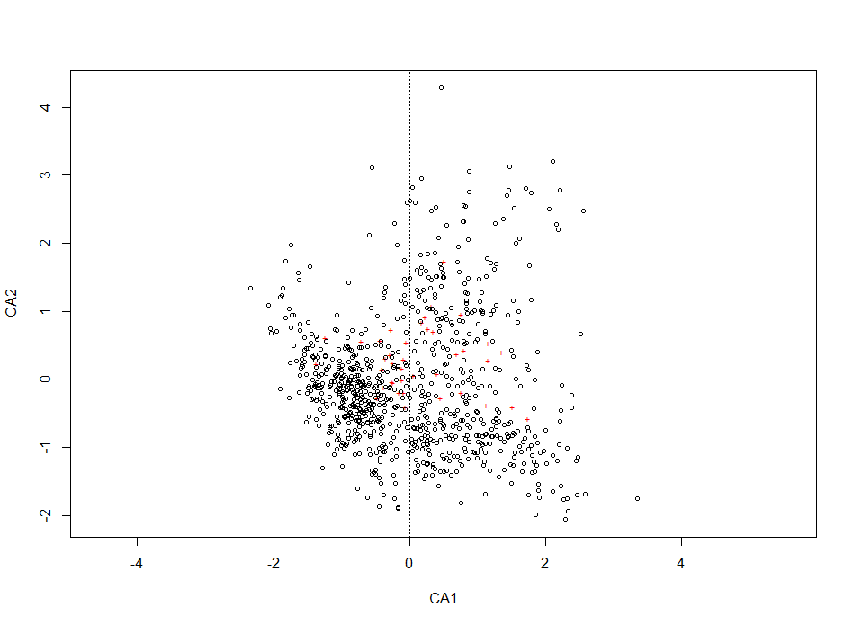
Temperature CCAs
January Temp CCA
July Temp CCA

Slide 3
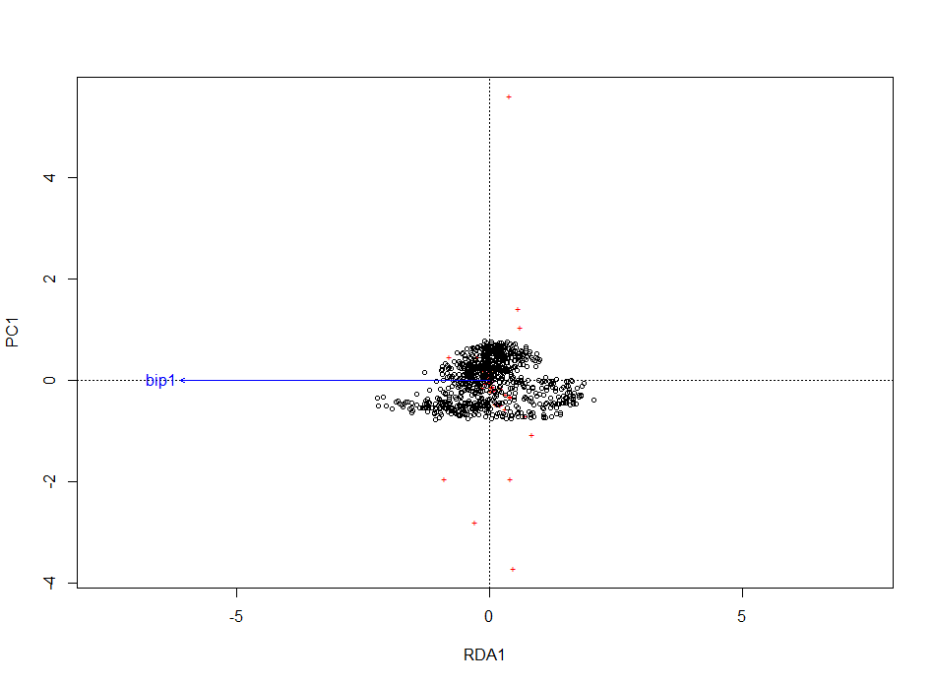
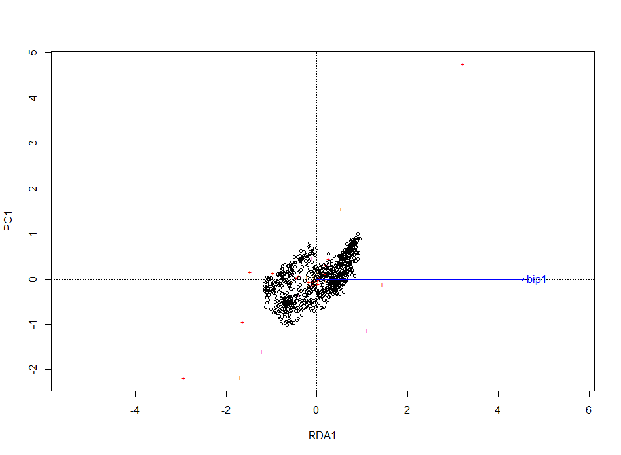
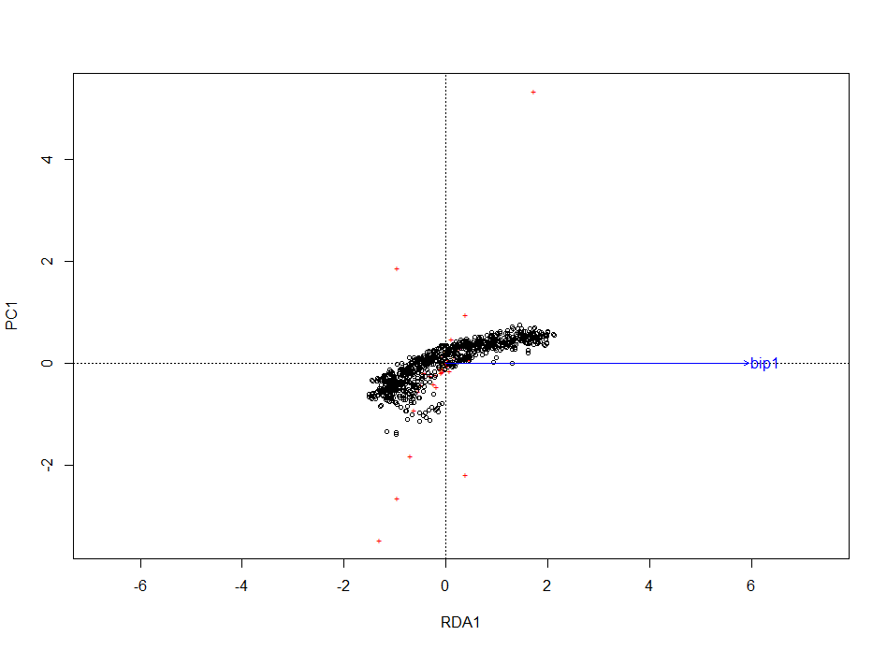

RDAs
January Temperature
July Temperature
Annual Precipitation
July Sunlight

Slide 4
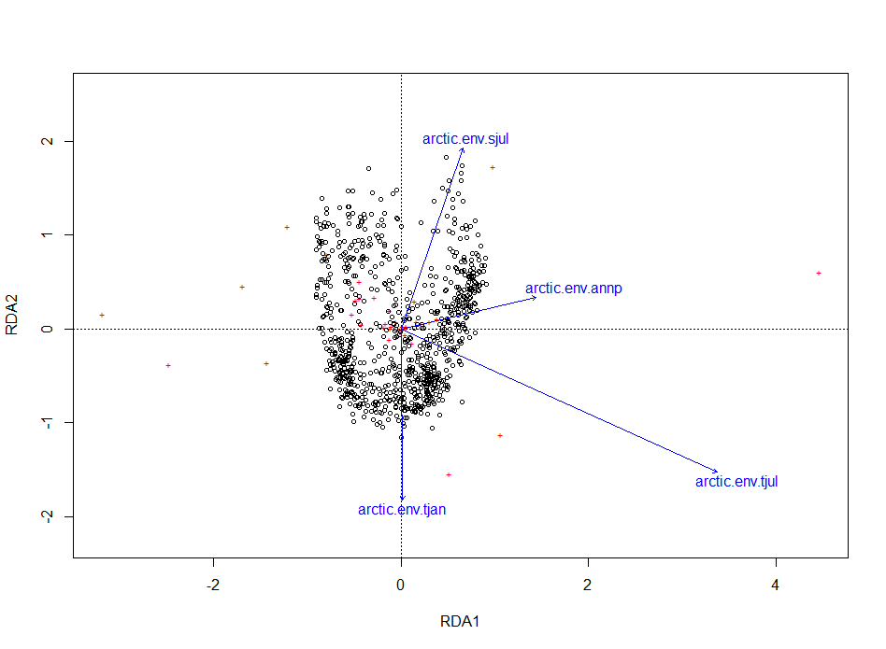
RDA Triplot

Slide 5
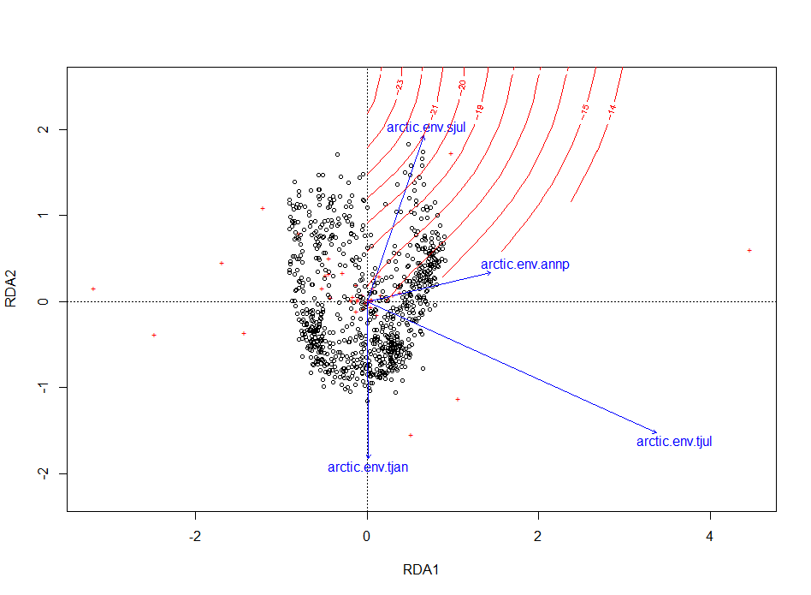
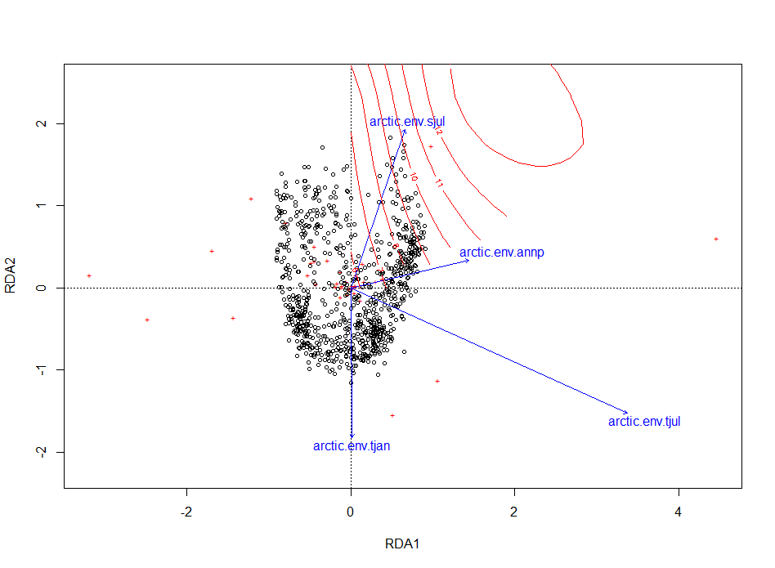

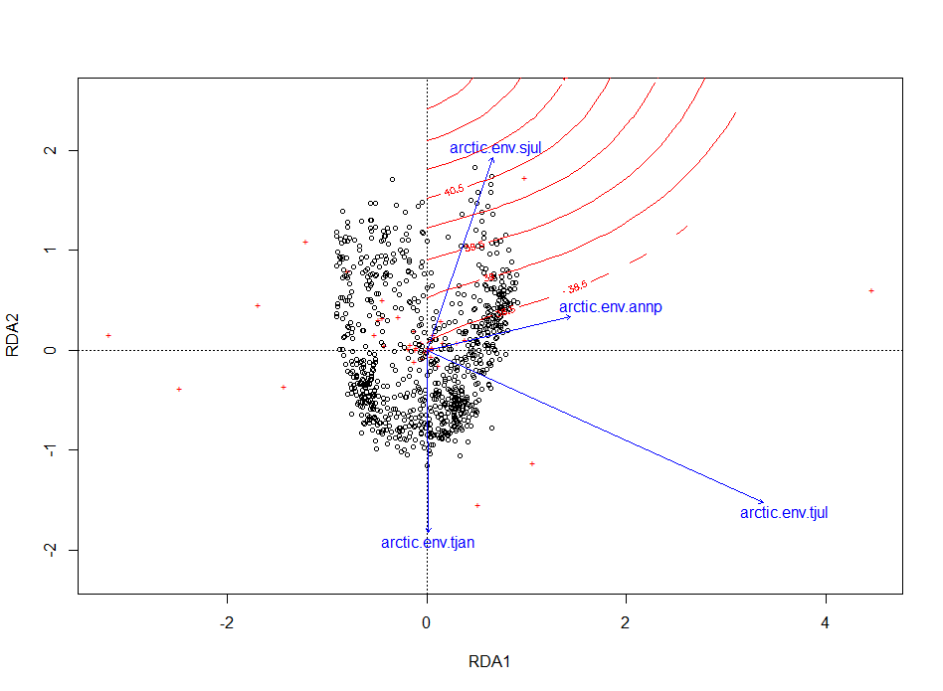
Triplots with Ordination Surfaces
January Temperature
July Temperature
Annual Precipitation
July Sunlight

Slide 6
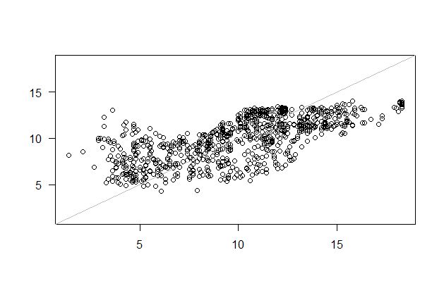
Taxa Weighted Average Model

Slide 7
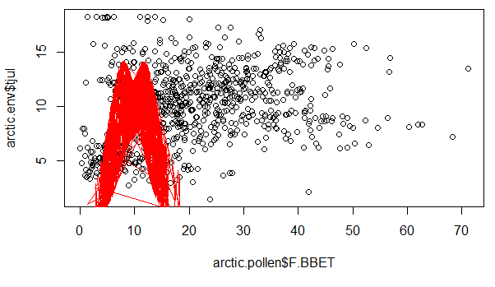
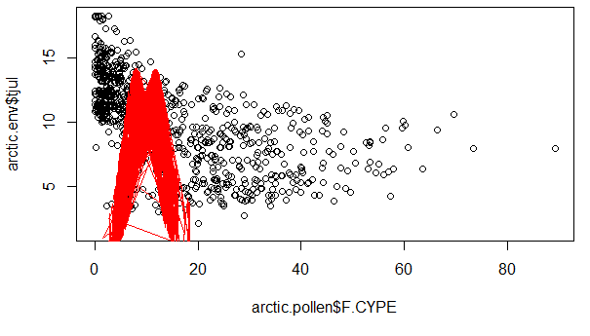
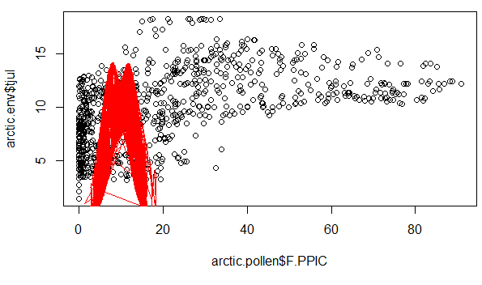
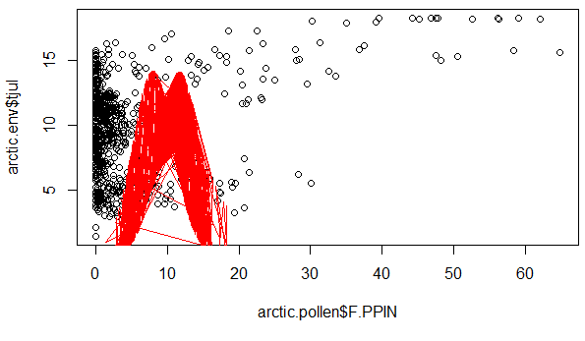
Taxa with Unimodal Response
F.CYPE
F.BBET
F.PPIC
F.PPIN

Slide 8
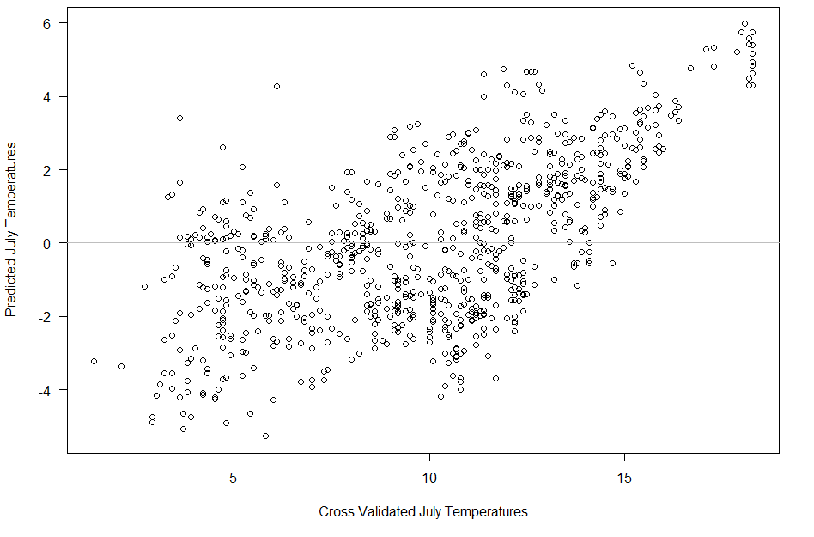
Cross Validation of WA Model

